Slide 1
PageRank
CSC 4760 / 6760 Big Data Programming
Spring 2018

Slide 2







Ranking the Websites
PageRank
More important websites are likely to receive more links from other websites.
World Wide Web
⁞
⁞
The PageRank citation ranking: bringing order to the web
Lawrence Page, Sergey Brin, Rajeev Motwani, and Terry Winograd
1998

Slide 3

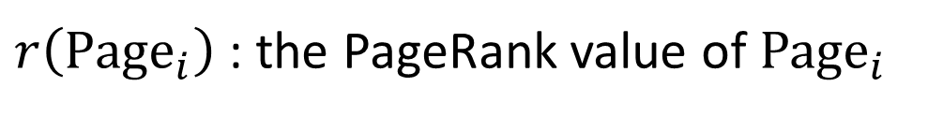
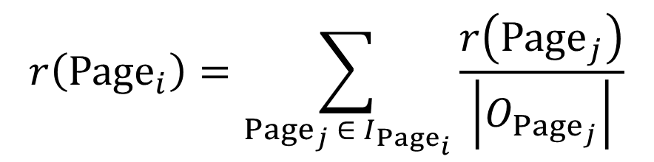


PageRank
B
C
A
$$r\left({Page}_{i}\right)=\sum_{{Page}_{j} ∈ I_{{Page}_{i}}}{\frac{r\left({Page}_{j}\right)}{\left|O_{{Page}_{j}}\right|}}$$
D
F
E
$r\left({Page}_{i}\right)$ : the PageRank value of ${Page}_{i}$
$I_{{Page}_{i}}$: the set of pages pointing into ${Page}_{i}$
$\left|O_{{Page}_{j}}\right|$: the number of outlinks from ${Page}_{i}$
The PageRank citation ranking: bringing order to the web Lawrence Page, Sergey Brin, Rajeev Motwani, and Terry Winograd
1998

Slide 4
PageRank
Page | PageRank Value
B | 0.384
C | 0.343
E | 0.081
D | 0.039
F | 0.039
A | 0.033
⋯ | ⋯
B
C
A
D
F
E
The PageRank citation ranking: bringing order to the web Lawrence Page, Sergey Brin, Rajeev Motwani, and Terry Winograd
1998

Slide 5

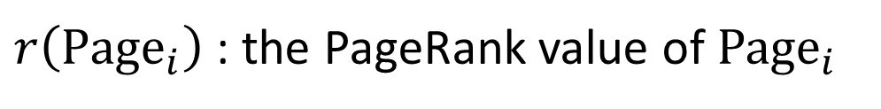

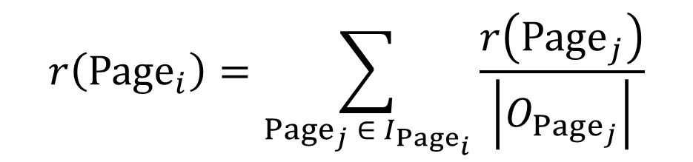
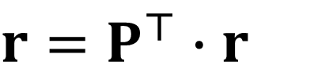

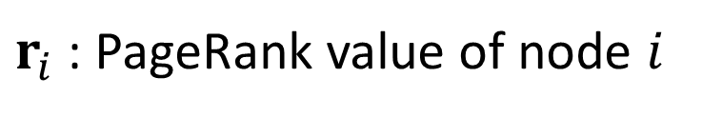

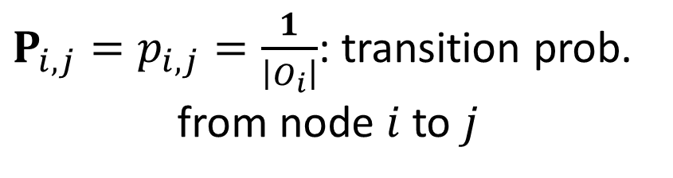
Matrix Form
$$r\left({Page}_{i}\right)=\sum_{{Page}_{j} ∈ I_{{Page}_{i}}}{\frac{r\left({Page}_{j}\right)}{\left|O_{{Page}_{j}}\right|}}$$
$$r=P^{⊤}∙r$$
$r$ : $n×1$ vector
$r\left({Page}_{i}\right)$ : the PageRank value of ${Page}_{i}$
$r_{i}$ : PageRank value of node $i$
$I_{{Page}_{i}}$: the set of pages pointing into ${Page}_{i}$
$P$ : transition matrix
$P_{i,j}=p_{i,j}=\frac{1}{\left|O_{i}\right|}$: transition prob. from node $i$ to $j$
$\left|O_{{Page}_{j}}\right|$: the number of outlinks from ${Page}_{j}$

Slide 6











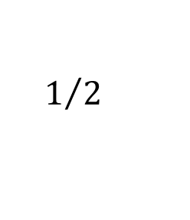






Graph and Matrices
Adjacency Matrix:
Transition Matrix:
$$1/2$$
$$5$$
$$4$$
 | 1 | 2 | 3 | 4 | 5
1 | 0 | 1 | 0 | 0 | 0
2 | 0 | 0 | 1 | 1 | 0
3 | 0 | 0 | 0 | 1 | 0
4 | 1 | 0 | 0 | 0 | 1
5 | 0 | 0 | 1 | 0 | 0
 | 1 | 2 | 3 | 4 | 5
1 | 0 | 1 | 0 | 0 | 0
2 | 0 | 0 | 0.5 | 0.5 | 0
3 | 0 | 0 | 0 | 1 | 0
4 | 0.5 | 0 | 0 | 0 | 0.5
5 | 0 | 0 | 1 | 0 | 0
$$1/2$$
$$1$$
$$A=$$
$$P=$$
$$1$$
$$1$$
$$1/2$$
$$3$$
$$1$$
$$1/2$$
$$2$$
Transition probability:
$$p_{i,j}$$
$$P_{i,j}=p_{i,j}$$
$$i$$
$$j$$
Notes:
Now we will describe this random walk process by using mathematical tools. Let us begin with the transition probabilities.
We use p_{i,j} to represent the transition probability from node i to node j. And we use a node-to-node transition matrix to contain all the transition probabilities. We use bold capital P to represent the transition matrix. Each row corresponds to a node. Each column also corresponds to a node. Each element represents the transition probability from a node to another. For example, this element 0.5 represents that the transition probability from node 4 to node 1 is 0.5.

Slide 7















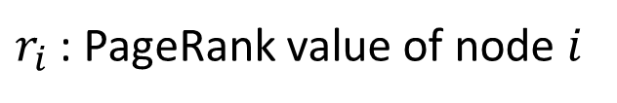


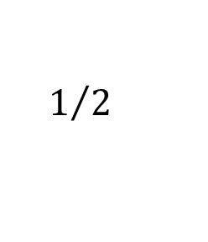



$$1/2$$
$$5$$
$$4$$
PageRank
$$1/2$$
$$1$$
$$1$$
$$1$$
$$1/2$$
$$3$$
$r_{i}$ : PageRank value of node $i$
$$1$$
$$1/2$$
$$2$$
$$r_{1}=r_{4}∙p_{4,1}$$
$$r=P^{⊤}∙r$$
$$\left(r_{i}=r_{i}\right)$$
$$r_{2}=r_{1}∙p_{1,2}$$
$$r_{3}=r_{2}∙p_{2,3}+r_{5}∙p_{5,3}$$
 | 1 | 2 | 3 | 4 | 5
1 | 0 | 0 | 0 | 0.5 | 0
2 | 1 | 0 | 0 | 0 | 0
3 | 0 | 0.5 | 0 | 0 | 1
4 | 0 | 0.5 | 1 | 0 | 0
5 | 0 | 0 | 0 | 0.5 | 0
$$P^{⊤}=$$
$$r_{4}=r_{2}∙p_{2,4}+r_{3}∙p_{3,4}$$
$$r_{5}=r_{4}∙p_{4,5}$$
If $P$ is primitive, there is a unique $r$
Notes:
After we define the transition probabilities and the transition matrix, we can analyze the random walk process.
We use r^t_i to represent the probability of visiting node i at time t. Based on the analysis of the random walk process in the previous slides, we can obtain this system of linear equations. It describes the random walk process from time point (t - 1) to t.
Since node 4 is the only incoming neighbor of node 1, the probability of visiting node 1 at time t is equal to the probability of visiting node 4 at time (t - 1) multiplied by the transition probability from node 4 to 1.
Node 1 is the only incoming neighbor of node 2. Thus the probability of visiting node 2 at time t is equal to the probability of visiting node 1 at time (t - 1) multiplied by the transition probability from node 1 to node 2.
Node 3 has two incoming neighbors, nodes 2 and 5. Thus, the probability of visiting node 3 at time t is equal to the probability of visiting node 2 at time (t - 1) multiplied by the transition probability from node 2 to 3 plus the probability of visiting node 5 at time (t - 1) multiplied by the transition probability from node 5 to 3.
Similarly, we can derive the equations for nodes 4 and 5.
This linear system can be represented in matrix form. We use bold r^t to represent a column vector. The i-th element of r^t vector represents the probability of visiting node i at time t. Then, we can obtain this linear equation. Vector r^t is equal to the transpose of matrix P multiplied by vector r^(t - 1). Matrix P represents the transition matrix.

Slide 8


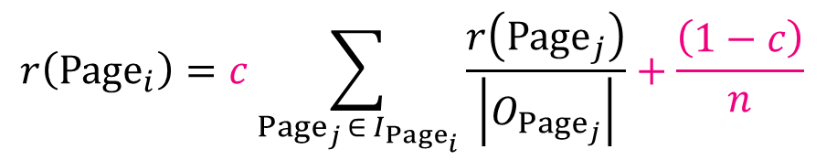

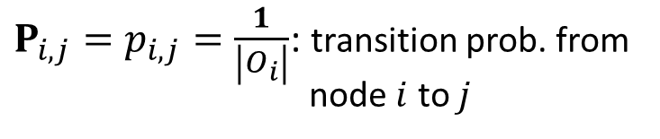

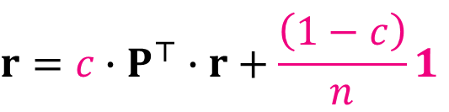

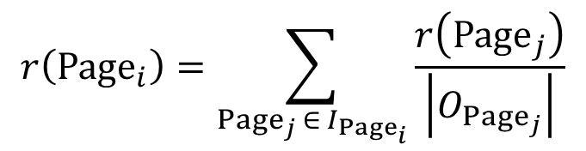



Modifications
$$r\left({Page}_{i}\right)=\sum_{{Page}_{j} ∈ I_{{Page}_{i}}}{\frac{r\left({Page}_{j}\right)}{\left|O_{{Page}_{j}}\right|}}$$
$$r=P^{⊤}∙r$$
$$r\left({Page}_{i}\right)=c\sum_{{Page}_{j} ∈ I_{{Page}_{i}}}{\frac{r\left({Page}_{j}\right)}{\left|O_{{Page}_{j}}\right|}}+\frac{\left(1−c\right)}{n}$$
$$r=c∙P^{⊤}∙r+\frac{\left(1−c\right)}{n}1$$
$1$ : $n×1$ vector of all 1’s
$r\left({Page}_{i}\right)$ : the PageRank value of ${Page}_{i}$
$r_{i}$ : PageRank value of node $i$
$I_{{Page}_{i}}$: the set of pages pointing into ${Page}_{i}$
$P$ : transition matrix
$\left|O_{{Page}_{j}}\right|$: the number of outlinks from ${Page}_{j}$
$P_{i,j}=p_{i,j}=\frac{1}{\left|O_{i}\right|}$: transition prob. from node $i$ to $j$
$c∈\left[0,1\right]$: decay factor, e.g. $c=0.85$
The PageRank citation ranking: bringing order to the web Lawrence Page, Sergey Brin, Rajeev Motwani, and Terry Winograd
1998
Notes:
A classic problem in graph analysis is to rank the nodes in a graph.
This figure shows a web graph, each node represents a web page, and each edge represents that there are hyperlinks between two web pages.
We need to rank the web pages based on their importance. PageRank is one graph algorithm which can rank the nodes in a graph. The basic assumption is that more important websites are likely to receive more links from other websites. The ranking results will be used in the web search engine. PageRank can be interpreted based on random walk. I will talk about this in the following slides.

Slide 9






$$1/2$$
$$5$$
$$4$$
PageRank
$$1/2$$
$$1$$
$$1$$
$$1$$
$$1/2$$
$$3$$
$r_{i}$ : PageRank value of node $i$
$$1$$
$$1/2$$
$$2$$
$$r_{1}=c∙r_{4}∙p_{4,1}+\left(1−c\right)/5$$
$$r=c∙P^{⊤}∙r+\left(1−c\right)1/n$$
$$\left(r_{i}=r_{i}\right)$$
$$r_{2}=c∙r_{1}∙p_{1,2}+\left(1−c\right)/5$$
$$r_{3}=c∙r_{2}∙p_{2,3}+c∙r_{5}∙p_{5,3}+\left(1−c\right)/5$$
 | 1 | 2 | 3 | 4 | 5
1 | 0 | 0 | 0 | 0.5 | 0
2 | 1 | 0 | 0 | 0 | 0
3 | 0 | 0.5 | 0 | 0 | 1
4 | 0 | 0.5 | 1 | 0 | 0
5 | 0 | 0 | 0 | 0.5 | 0
$$P^{⊤}=$$
$$r_{4}=c∙r_{2}∙p_{2,4}+c∙r_{3}∙p_{3,4}+\left(1−c\right)/5$$
$$r_{5}=c∙r_{4}∙p_{4,5}+\left(1−c\right)/5$$
For any $P$, there is a unique $r$
Notes:
After we define the transition probabilities and the transition matrix, we can analyze the random walk process.
We use r^t_i to represent the probability of visiting node i at time t. Based on the analysis of the random walk process in the previous slides, we can obtain this system of linear equations. It describes the random walk process from time point (t - 1) to t.
Since node 4 is the only incoming neighbor of node 1, the probability of visiting node 1 at time t is equal to the probability of visiting node 4 at time (t - 1) multiplied by the transition probability from node 4 to 1.
Node 1 is the only incoming neighbor of node 2. Thus the probability of visiting node 2 at time t is equal to the probability of visiting node 1 at time (t - 1) multiplied by the transition probability from node 1 to node 2.
Node 3 has two incoming neighbors, nodes 2 and 5. Thus, the probability of visiting node 3 at time t is equal to the probability of visiting node 2 at time (t - 1) multiplied by the transition probability from node 2 to 3 plus the probability of visiting node 5 at time (t - 1) multiplied by the transition probability from node 5 to 3.
Similarly, we can derive the equations for nodes 4 and 5.
This linear system can be represented in matrix form. We use bold r^t to represent a column vector. The i-th element of r^t vector represents the probability of visiting node i at time t. Then, we can obtain this linear equation. Vector r^t is equal to the transpose of matrix P multiplied by vector r^(t - 1). Matrix P represents the transition matrix.

Slide 10




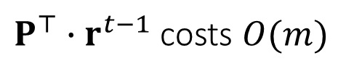









Power Iteration Method
PageRank
$$r^{0}=1/n$$
$$r=c∙P^{⊤}∙r+\left(1−c\right)1/n$$
$$r^{1}=c∙P^{⊤}∙r^{0}+\left(1−c\right)1/n$$
$$r^{2}=c∙P^{⊤}∙r^{1}+\left(1−c\right)1/n$$
$$⋯$$
$$r^{t}=c∙P^{⊤}∙r^{t−1}+\left(1−c\right)1/n$$
$$⋯$$
$$r^{∞}→r$$
Time Complexity
$$O(βm)$$
$P^{⊤}∙r^{t−1}$ costs $O(m)$
$$\left\|r^{β}−r^{β−1}\right\|<ε$$
$1$ : $n×1$ vector of all 1’s
$q$ : $n×1$ vector, $q_{q}=1$, $q_{i}=0, i≠q$
$n$ : number of nodes; $m$ : number of edges;

Slide 11






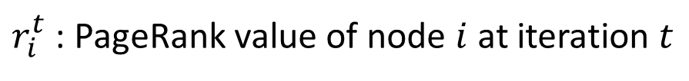


$$1/2$$
$$5$$
$$4$$
Power Iteration
$$1/2$$
$$1$$
$$1$$
$$c=0.85$$
$$1$$
$$1/2$$
$$3$$
$r_{i}^{t}$ : PageRank value of node $i$ at iteration $t$
$$1$$
$$1/2$$
$$(r_{i}^{t}=r_{i}^{t})$$
$$2$$
$$r_{1}^{t}=c∙r_{4}^{t−1}∙p_{4,1}+\left(1−c\right)/5$$
$$r_{2}^{t}=c∙r_{1}^{t−1}∙p_{1,2}+\left(1−c\right)/5$$
$$r^{t}=c∙P^{⊤}∙r^{t−1}+\left(1−c\right)1/n$$
$$r_{3}^{t}=c∙r_{2}^{t−1}∙p_{2,3}+c∙r_{5}^{t−1}∙p_{5,3}+\left(1−c\right)/5$$
 | 1 | 2 | 3 | 4 | 5
1 | 0 | 0 | 0 | 0.5 | 0
2 | 1 | 0 | 0 | 0 | 0
3 | 0 | 0.5 | 0 | 0 | 1
4 | 0 | 0.5 | 1 | 0 | 0
5 | 0 | 0 | 0 | 0.5 | 0
$$r_{4}^{t}=c∙r_{2}^{t−1}∙p_{2,4}+c∙r_{3}^{t−1}∙p_{3,4}+\left(1−c\right)/5$$
$$P^{⊤}=$$
$$r^{0}=$$
1 | 0.2
2 | 0.2
3 | 0.2
4 | 0.2
5 | 0.2
$$r_{5}^{t}=c∙r_{4}^{t−1}∙p_{4,5}+\left(1−c\right)/5$$
Notes:
After we define the transition probabilities and the transition matrix, we can analyze the random walk process.
We use r^t_i to represent the probability of visiting node i at time t. Based on the analysis of the random walk process in the previous slides, we can obtain this system of linear equations. It describes the random walk process from time point (t - 1) to t.
Since node 4 is the only incoming neighbor of node 1, the probability of visiting node 1 at time t is equal to the probability of visiting node 4 at time (t - 1) multiplied by the transition probability from node 4 to 1.
Node 1 is the only incoming neighbor of node 2. Thus the probability of visiting node 2 at time t is equal to the probability of visiting node 1 at time (t - 1) multiplied by the transition probability from node 1 to node 2.
Node 3 has two incoming neighbors, nodes 2 and 5. Thus, the probability of visiting node 3 at time t is equal to the probability of visiting node 2 at time (t - 1) multiplied by the transition probability from node 2 to 3 plus the probability of visiting node 5 at time (t - 1) multiplied by the transition probability from node 5 to 3.
Similarly, we can derive the equations for nodes 4 and 5.
This linear system can be represented in matrix form. We use bold r^t to represent a column vector. The i-th element of r^t vector represents the probability of visiting node i at time t. Then, we can obtain this linear equation. Vector r^t is equal to the transpose of matrix P multiplied by vector r^(t - 1). Matrix P represents the transition matrix.

Slide 12





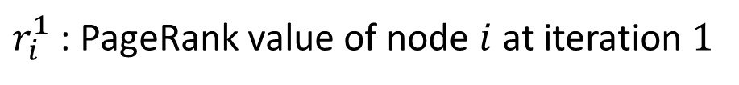


1 | 0.115
2 | 0.200
3 | 0.285
4 | 0.285
5 | 0.115
$$1/2$$
$$5$$
$$r^{1}=$$
$$4$$
Power Iteration
$$1/2$$
$$1$$
$$1$$
$$c=0.85$$
$$1$$
$$1/2$$
$$3$$
$r_{i}^{1}$ : PageRank value of node $i$ at iteration $1$
$$1$$
$$1/2$$
$$(r_{i}^{1}=r_{i}^{1})$$
$$2$$
$$r_{1}^{1}=0.85∙0.2∙0.5+\left(1−0.85\right)/5$$
$$r_{2}^{1}=0.85∙0.2∙1+\left(1−0.85\right)/5$$
$$r^{1}=c∙P^{⊤}∙r^{1−1}+\left(1−c\right)1/n$$
$$r_{3}^{1}=0.85∙0.2∙0.5+0.85∙0.2∙1+\left(1−0.85\right)/5$$
 | 1 | 2 | 3 | 4 | 5
1 | 0 | 0 | 0 | 0.5 | 0
2 | 1 | 0 | 0 | 0 | 0
3 | 0 | 0.5 | 0 | 0 | 1
4 | 0 | 0.5 | 1 | 0 | 0
5 | 0 | 0 | 0 | 0.5 | 0
$$r_{4}^{1}=0.85∙0.2∙0.5+0.85∙0.2∙1+\left(1−0.85\right)/5$$
$$P^{⊤}=$$
$$r^{0}=$$
1 | 0.2
2 | 0.2
3 | 0.2
4 | 0.2
5 | 0.2
$$r_{5}^{1}=0.85∙0.2∙0.5+\left(1−0.85\right)/5$$
Notes:
After we define the transition probabilities and the transition matrix, we can analyze the random walk process.
We use r^t_i to represent the probability of visiting node i at time t. Based on the analysis of the random walk process in the previous slides, we can obtain this system of linear equations. It describes the random walk process from time point (t - 1) to t.
Since node 4 is the only incoming neighbor of node 1, the probability of visiting node 1 at time t is equal to the probability of visiting node 4 at time (t - 1) multiplied by the transition probability from node 4 to 1.
Node 1 is the only incoming neighbor of node 2. Thus the probability of visiting node 2 at time t is equal to the probability of visiting node 1 at time (t - 1) multiplied by the transition probability from node 1 to node 2.
Node 3 has two incoming neighbors, nodes 2 and 5. Thus, the probability of visiting node 3 at time t is equal to the probability of visiting node 2 at time (t - 1) multiplied by the transition probability from node 2 to 3 plus the probability of visiting node 5 at time (t - 1) multiplied by the transition probability from node 5 to 3.
Similarly, we can derive the equations for nodes 4 and 5.
This linear system can be represented in matrix form. We use bold r^t to represent a column vector. The i-th element of r^t vector represents the probability of visiting node i at time t. Then, we can obtain this linear equation. Vector r^t is equal to the transpose of matrix P multiplied by vector r^(t - 1). Matrix P represents the transition matrix.

Slide 13






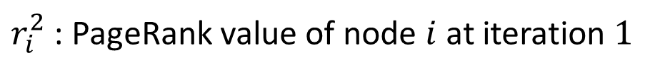


$$1/2$$
$$5$$
$$r^{2}=$$
1 | 0.1511
2 | 0.1278
3 | 0.2128
4 | 0.3573
5 | 0.1511
$$4$$
Power Iteration
$$1/2$$
$$1$$
$$1$$
$$c=0.85$$
$$1$$
$$1/2$$
$$3$$
$r_{i}^{2}$ : PageRank value of node $i$ at iteration $1$
$$1$$
$$1/2$$
$$(r_{i}^{2}=r_{i}^{2})$$
$$2$$
$$r_{1}^{2}=0.85∙0.285∙0.5+\left(1−0.85\right)/5$$
$$r_{2}^{2}=0.85∙0.115∙1+\left(1−0.85\right)/5$$
$$r^{2}=c∙P^{⊤}∙r^{2−1}+\left(1−c\right)1/n$$
$$r_{3}^{2}=0.85∙0.2∙0.5+0.85∙0.115∙1+\left(1−0.85\right)/5$$
$$P^{⊤}=$$
 | 1 | 2 | 3 | 4 | 5
1 | 0 | 0 | 0 | 0.5 | 0
2 | 1 | 0 | 0 | 0 | 0
3 | 0 | 0.5 | 0 | 0 | 1
4 | 0 | 0.5 | 1 | 0 | 0
5 | 0 | 0 | 0 | 0.5 | 0
$$r_{4}^{2}=0.85∙0.2∙0.5+0.85∙0.285∙1+\left(1−0.85\right)/5$$
$$r^{1}=$$
1 | 0.115
2 | 0.200
3 | 0.285
4 | 0.285
5 | 0.115
$$r_{5}^{2}=0.85∙0.285∙0.5+\left(1−0.85\right)/5$$
Notes:
After we define the transition probabilities and the transition matrix, we can analyze the random walk process.
We use r^t_i to represent the probability of visiting node i at time t. Based on the analysis of the random walk process in the previous slides, we can obtain this system of linear equations. It describes the random walk process from time point (t - 1) to t.
Since node 4 is the only incoming neighbor of node 1, the probability of visiting node 1 at time t is equal to the probability of visiting node 4 at time (t - 1) multiplied by the transition probability from node 4 to 1.
Node 1 is the only incoming neighbor of node 2. Thus the probability of visiting node 2 at time t is equal to the probability of visiting node 1 at time (t - 1) multiplied by the transition probability from node 1 to node 2.
Node 3 has two incoming neighbors, nodes 2 and 5. Thus, the probability of visiting node 3 at time t is equal to the probability of visiting node 2 at time (t - 1) multiplied by the transition probability from node 2 to 3 plus the probability of visiting node 5 at time (t - 1) multiplied by the transition probability from node 5 to 3.
Similarly, we can derive the equations for nodes 4 and 5.
This linear system can be represented in matrix form. We use bold r^t to represent a column vector. The i-th element of r^t vector represents the probability of visiting node i at time t. Then, we can obtain this linear equation. Vector r^t is equal to the transpose of matrix P multiplied by vector r^(t - 1). Matrix P represents the transition matrix.

Slide 14

$$1/2$$
$$5$$
$$r^{∞}=$$
1 | 0.1556
2 | 0.1622
3 | 0.2312
4 | 0.2955
5 | 0.1556
$$4$$
Power Iteration
$$1/2$$
$$1$$
$$1$$
$$c=0.85$$
$$1$$
$$1/2$$
$$3$$
$r_{i}^{t}$ : PageRank value of node $i$ at iteration $t$
$$1$$
$$1/2$$
$$(r_{i}^{t}=r_{i}^{t})$$
$$2$$
$$r_{1}^{t}=c∙r_{4}^{t−1}∙p_{4,1}+\left(1−c\right)/5$$
$$r_{2}^{t}=c∙r_{1}^{t−1}∙p_{1,2}+\left(1−c\right)/5$$
$$r^{t}=c∙P^{⊤}∙r^{t−1}+\left(1−c\right)1/n$$
$$r_{3}^{t}=c∙r_{2}^{t−1}∙p_{2,3}+c∙r_{5}^{t−1}∙p_{5,3}+\left(1−c\right)/5$$
 | 1 | 2 | 3 | 4 | 5
1 | 0 | 0 | 0 | 0.5 | 0
2 | 1 | 0 | 0 | 0 | 0
3 | 0 | 0.5 | 0 | 0 | 1
4 | 0 | 0.5 | 1 | 0 | 0
5 | 0 | 0 | 0 | 0.5 | 0
$$r_{4}^{t}=c∙r_{2}^{t−1}∙p_{2,4}+c∙r_{3}^{t−1}∙p_{3,4}+\left(1−c\right)/5$$
$$P^{⊤}=$$
$$r^{0}=$$
1 | 0.2
2 | 0.2
3 | 0.2
4 | 0.2
5 | 0.2
$$r_{5}^{t}=c∙r_{4}^{t−1}∙p_{4,5}+\left(1−c\right)/5$$
Notes:
After we define the transition probabilities and the transition matrix, we can analyze the random walk process.
We use r^t_i to represent the probability of visiting node i at time t. Based on the analysis of the random walk process in the previous slides, we can obtain this system of linear equations. It describes the random walk process from time point (t - 1) to t.
Since node 4 is the only incoming neighbor of node 1, the probability of visiting node 1 at time t is equal to the probability of visiting node 4 at time (t - 1) multiplied by the transition probability from node 4 to 1.
Node 1 is the only incoming neighbor of node 2. Thus the probability of visiting node 2 at time t is equal to the probability of visiting node 1 at time (t - 1) multiplied by the transition probability from node 1 to node 2.
Node 3 has two incoming neighbors, nodes 2 and 5. Thus, the probability of visiting node 3 at time t is equal to the probability of visiting node 2 at time (t - 1) multiplied by the transition probability from node 2 to 3 plus the probability of visiting node 5 at time (t - 1) multiplied by the transition probability from node 5 to 3.
Similarly, we can derive the equations for nodes 4 and 5.
This linear system can be represented in matrix form. We use bold r^t to represent a column vector. The i-th element of r^t vector represents the probability of visiting node i at time t. Then, we can obtain this linear equation. Vector r^t is equal to the transpose of matrix P multiplied by vector r^(t - 1). Matrix P represents the transition matrix.

Slide 15


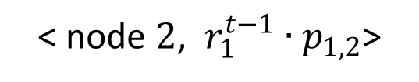
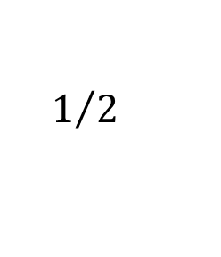






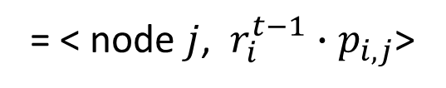



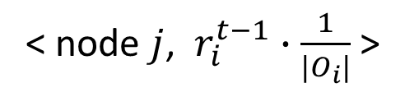


Power Iteration method in MapReduce
Mapper
Input:
PageRank value $r_{i}^{t−1}$ of node $i$
$$1/2$$
$$5$$
$$4$$
Outlinks $O_{i}$ of node $i$ (one row of the adjacency matrix)
$$1/2$$
$$1$$
$$1$$
Output:
For each node $j∈O_{i}$ , output
$$1$$
$$1/2$$
$$3$$
< node $j$, $r_{i}^{t−1}∙\frac{1}{|O_{i}|}$>
$$1$$
$$1/2$$
$$2$$
= < node $j$, $r_{i}^{t−1}∙p_{i,j}$>
Mapper processes node 1
< node $2$, $r_{1}^{t−1}∙p_{1,2}$>

Slide 16
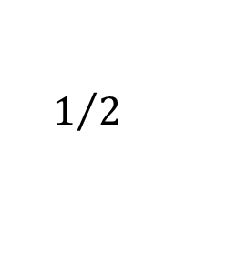


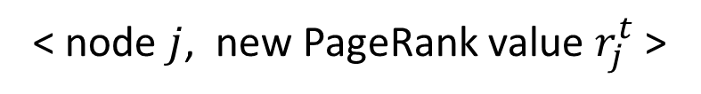


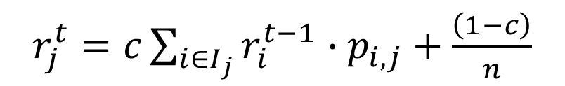
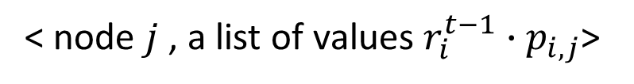
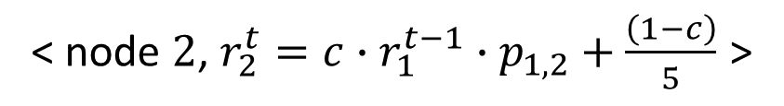


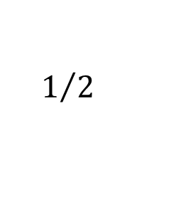


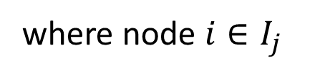



Power Iteration method in MapReduce
Reducer
$$1/2$$
$$5$$
Input:
< node $j$ , a list of values $r_{i}^{t−1}∙p_{i,j}$>
$$4$$
$$1/2$$
$$1$$
$$1$$
where node $i∈I_{j}$
$$1$$
$$1/2$$
$$3$$
Output:
< node $j$, new PageRank value $r_{j}^{t}$ >
$$1$$
$$1/2$$
$$2$$
$r_{j}^{t}=c\sum_{i∈I_{j}}{r_{i}^{t−1}∙p_{i,j}}+\frac{\left(1−c\right)}{n}$
Mapper processes node 2
$I_{j}$: the set of in-neighbor nodes
< node $2$, $r_{2}^{t}=c∙r_{1}^{t−1}∙p_{1,2}+\frac{\left(1−c\right)}{5}$ >

Slide 17



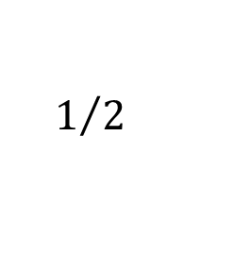



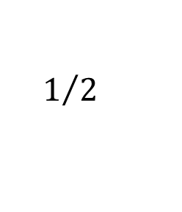







The input files
Initial PageRank values
Adjacency list
PageRank values
$$1/2$$
$$5$$
$$r^{0}=$$
1 0.2
2 0.2
3 0.2
4 0.2
5 0.2
$$A=$$
1 2
2 3 4
3 4
4 1 5
5 3
$$r^{∞}=$$
1 ???
2 ???
3 ???
4 ???
5 ???
$$4$$
$$1/2$$
$$1$$
$$1$$
$$1$$
$$1/2$$
$$3$$
$$1$$
$$1/2$$
$$2$$

Slide 18
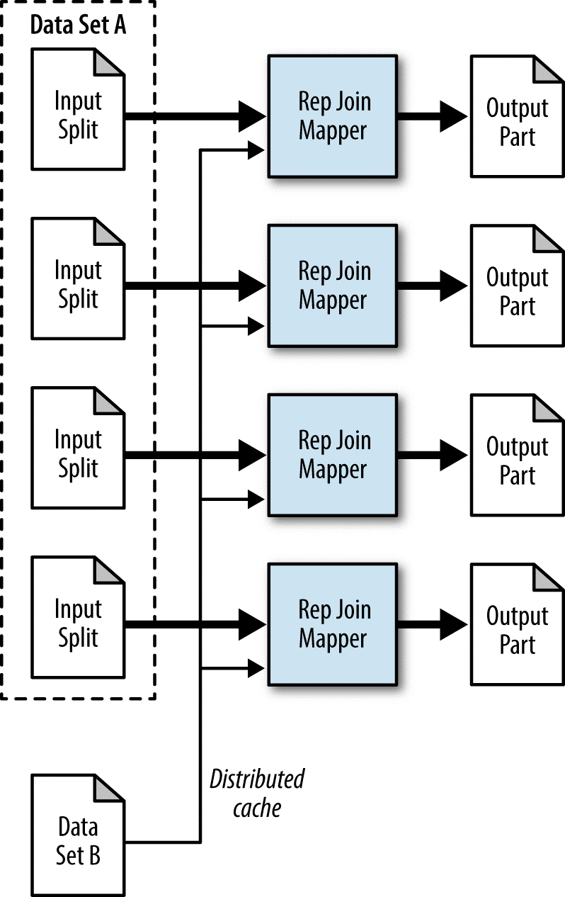
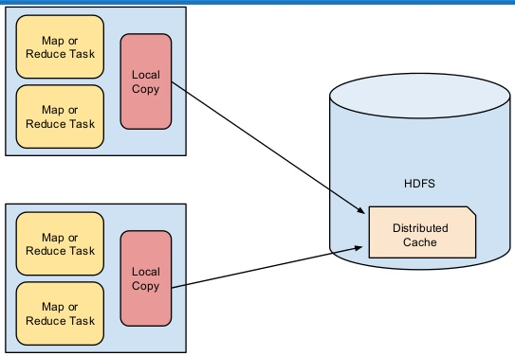
Distributed Cache in Hadoop
Replicated join data flow

Slide 19
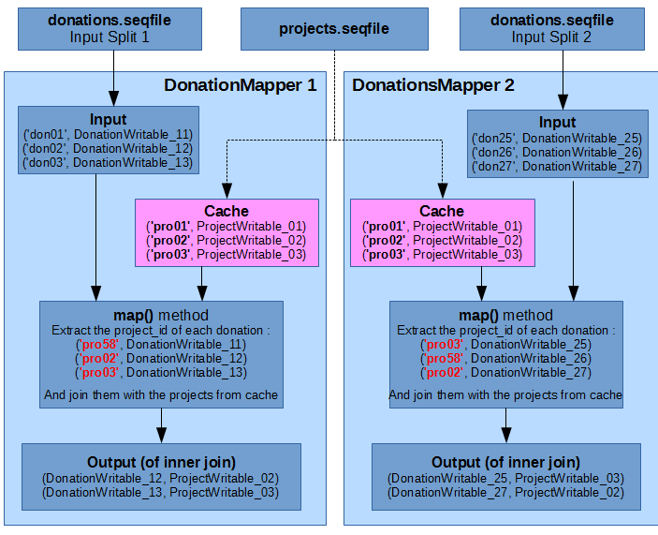
Distributed Cache in Hadoop

Slide 20
PageRank.java
args[0] : Initial PageRank values
args[1] : Adjacency list file
args[2] : Output Directory
args[3] : Number of Iterations
data file must be uploaded into HDFS. Local files will cause error.
(30)
01InitialPRValues.txt
02AdjacencyList.txt
PageRankValue.txt
1 0.2
2 0.2
3 0.2
4 0.2
5 0.2
1 2
2 3 4
3 4
4 1 5
5 3
1 ???
2 ???
3 ???
4 ???
5 ???
+
hadoop jar PageRank.jar /user/rob/pagerank/01InitialPRValues.txt /user/rob/pagerank/02AdjacencyList.txt /user/rob/pagerank/out01 30

Slide 21
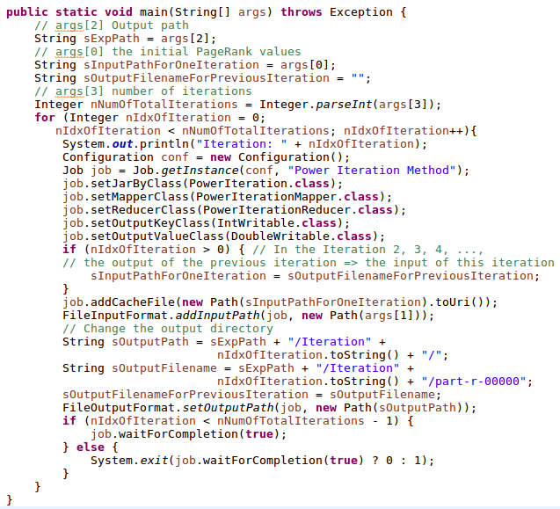
PageRank.java – main()

Slide 22
PageRank.java – Mapper
Will be updated after the submission of Assignment 2

Slide 23
PageRank.java – Reducer
Will be updated after the submission of Assignment 2

